Slide 1
10 steps to DevOps Part 10: Monitor and Analyze
James Tramel
Developer Strategist
james.tramel@microsoft.com
Notes:
a

Slide 2

Every app Every Developer Every Platform
Visual Studio Online
Visual Studio
.NET
Notes:
The tool for everything. .net, sharepoint – web forms.
Mobile development - pokemon
Web Developer – notepad – web extensions
Javascript – typescript angular.
Talking Points
With the increase and diversity of devices there is an opportunity for developers to reach users where they are.
Also with the power of the cloud, infrastructure and capital expenditures no longer have to be a barrier to creating great applications.
Visual Studio 2015 bridges mobile and the cloud by being the first version built to target mobile-first and cloud-first development.

Slide 3
Software delivery challenges
?
Frustration
Delays
Lack of insights

Slide 4
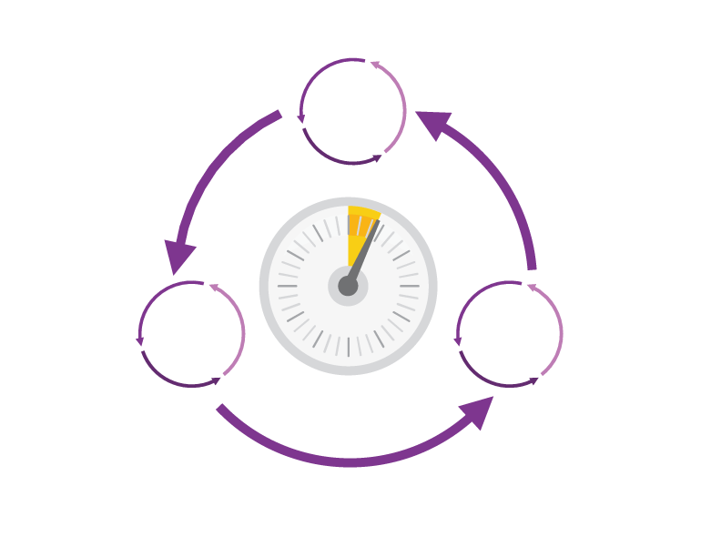
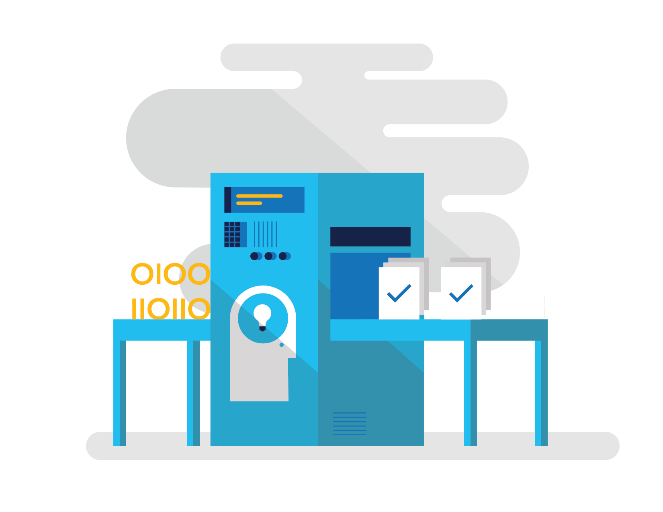

How Microsoft can help
Shorten Cycle Times
Optimize Resources
Improve Quality and Availablilty
Speed up and increase traceability of each release by empowering your development and operations teams with advanced collaboration and automation tools.
Efficiently manage environments using technologies that support self-service provisioning in a secure way, in line with your IT governance standards.
Capture rich telemetry on application performance and usage so that you can make better decisions on future investments and anticipate issues in production before they impact your service.
Visual Studio Team Services
Microsoft Azure
Visual Studio
Notes:
The Microsoft DevOps Solution provides a comprehensive set of software, cloud services, and other essential resources that help you deliver higher-quality software faster with less risk.
This solution is focused on addressing the most pressing challenges of the modern application lifecycle:
Shortening cycle times through advanced release management and automation tools
Optimizing resources and eliminating waste, and
Increasing quality and availability of your solutions

Slide 5






DevOps: the three components
DEV
OPS
1
People
2
Process
3
Products
Notes:
DevOps is the union of people, process, and products to enable continuous delivery of value to our end users.”\\
Focus today, from me, is process and products. Will focus on the how. The people is you. Be the change you want to see.

Slide 6
DevOps
1
4
Plan
Monitor + Learn
Development
Production
2
3
Develop + Test
Release

Slide 7
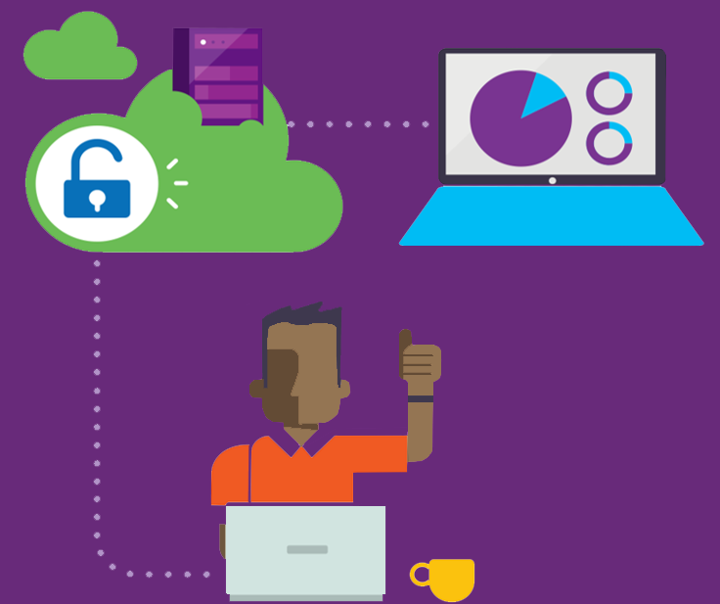
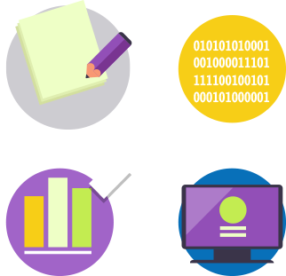


Visual Studio Enterprise – the tool for DevOps
Optimized for enterprise-class development
An integrated, end-to-end solution for teams of any size with demanding quality and scale needs. Take advantage of comprehensive tools and services for designing, building and managing complex enterprise solutions.
Greater productivity for enterprise application development and delivery
Plan, execute and monitor your entire quality effort, continuously
Manage complexity and close
the loop between Dev and Ops
Notes:
The tool for everything. .net, sharepoint – web forms.
Web Developer – notepad – web extensions
Javascript – typescript angular.

Slide 8
DevOps habits and practices
BACKLOG refined with LEARNING
MANAGED TECHNICAL DEBT
PRODUCTION FIRST MINDSET
INFRA-STRUCTURE is a FLEXIBLE RESOURCE
TEAM AUTONOMY & ENTERPRISE ALIGNMENT
EVIDENCE gathered in PRODUCTION
FLOW OF CUSTOMER VALUE

Slide 9
DevOps habits and practices
LEARN
Application Performance Management
Infrastructure as Code
Continuous Deployment
Release Management
Configuration Management
Automated Recovery
PLAN
Source Control
Stakeholder Feedback
Kanban
Bug Tracking
TEST
Application Performance Management
Usage Monitoring
Telemetry Collection Testing in Production
Stakeholder Feedback
APPROVE
Feature flags
Code Reviews
Automated Testing
Continuous Measurement
BACKLOG refined with LEARNING
MANAGED TECHNICAL DEBT
PRODUCTION FIRST MINDSET
INFRA-STRUCTURE is a FLEXIBLE RESOURCE
TEAM AUTONOMY & ENTERPRISE ALIGNMENT
EVIDENCE gathered in PRODUCTION
FLOW OF CUSTOMER VALUE
APP
Automated Testing
Code Review
Technical Debt
Continuous Integration
Continuous Deployment
Release Management
iNFRA
Automated Enviornment De Provision
Self Service Enviornment
Auotmated Recovery
MONITOR
Infrastructure as Code
Continuous Delivery
Release Management
Configuration Management
Automated Recovery
Testing in Production
Usage Monitoring
User Telemetry
Notes:
Automated Testing
Continuous Integration
Continuous Deployment
Release Management
Usage Monitoring
Telemetry Collection
Testing in Production
Application Performance Management
Infrastructure as Code
Continuous Delivery
Release Management
Change / Configuration Management
Automated Recovery
Load Testing
Avaialability Monitoring
Capactiy Management
Automated Enviornment De Provision
Self Service Enviornment
Auotmated Recovery (roll back / roll forward)
Stakeholder Feedback
Feature flags
Code Reviews / Technical Debt

Slide 10
Dev Ops Skill Katas
Modern Debugging
Automated Unit Testing and Architectural mapping
Work item / bug tracking / Continuous Test
Continuous deployment / integration
Infrastructure as code
Integrated testing / technical debt management
Release management
Dev / test environments
Continuous configuration / package management
Monitor and analyze
Notes:
Social club – intellitrace – works on anything .net
Taxation – intellitest and code maps
Sonar qube – vstsdemo – my shuttle 2 – myshuttle ci
https://sonarqube.com/, click rules
Package manager – parts unlimited – build – surreal engine – show feeds
Continuous integration – click on triggersin a build
Continuous deployment – parts unlimited
http://partsunlimited.azurewebsites.net/
Show deployment slots
Azurejut – dupont welcome -
Release – show Aramark azurejt
IAC – show github repo
Show create a new resource
https://github.com/Azure/azure-quickstart-templates
Dev test labs – en portal
Monitor and analytiz – so java portal or farkacam on my portal

Slide 11
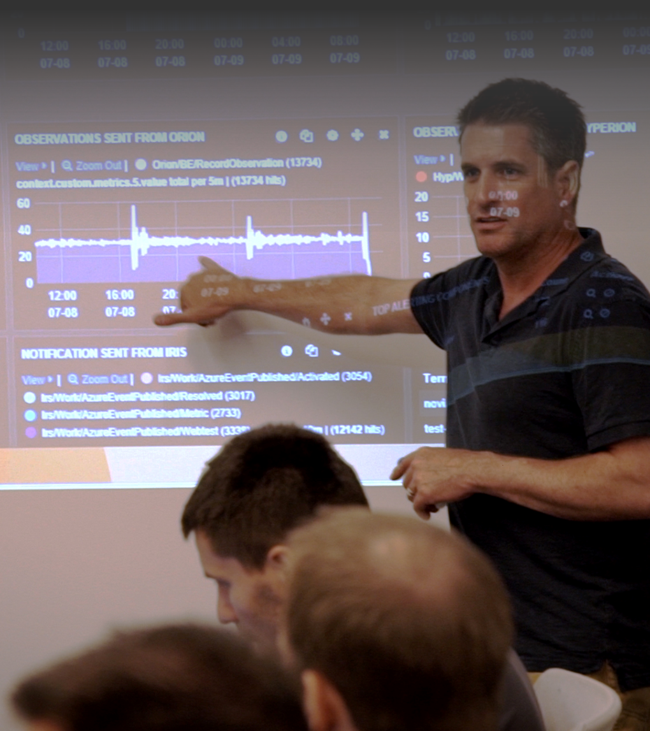
Answer questions like …
Is my application crashing?
What exactly happened?
Is my application fast enough?
Is my server able to handle the load?
How responsive are my dependencies?
Is my application UP or DOWN?
What is the root cause?
How many people are impacted?

Slide 12
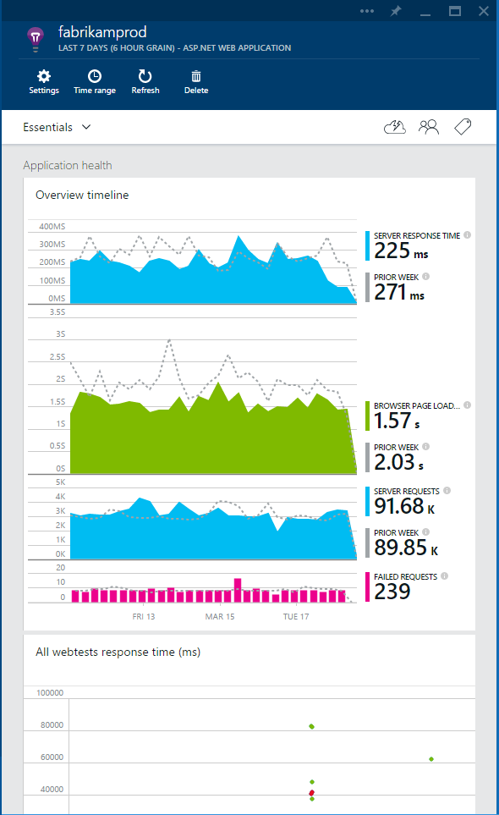
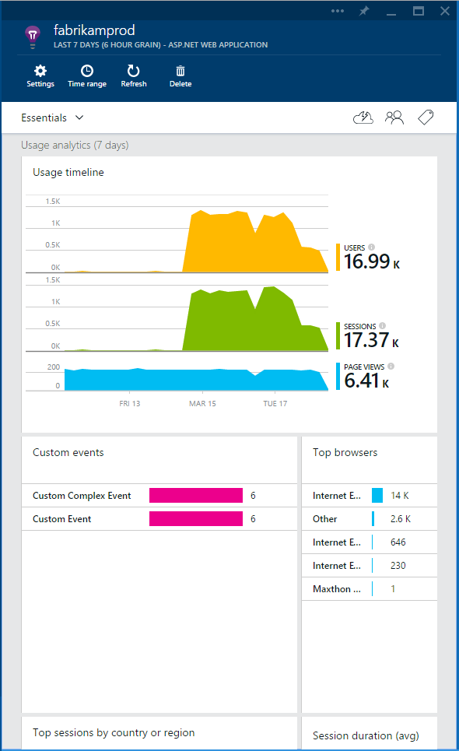

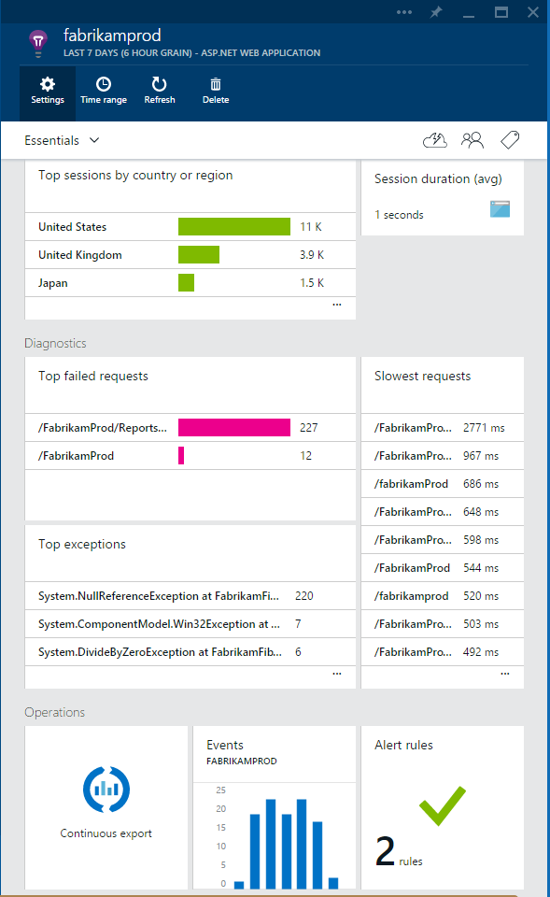

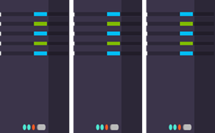
Application Insights
3
Get a 360° view of the application including availability, performance and usage patterns
1
Telemetry is collected at each tier: mobile applications, server applications and browser
2
Telemetry arrives in the Application Insights service in the cloud where it is processed & stored
Notes:
Whether you are in production or development Application Insights for Visual Studio Online offers a set of developer services to give you actionable insight into the availability, performance and usage of your applications.
Get a 360° view of your application that includes availability and performance as well as user behavior
Use a powerful, easy-to-use experience to track and improve the availability, performance, and success of your app
Explore and analyze across dimensions so you can make informed decisions about your product’s future

Slide 13
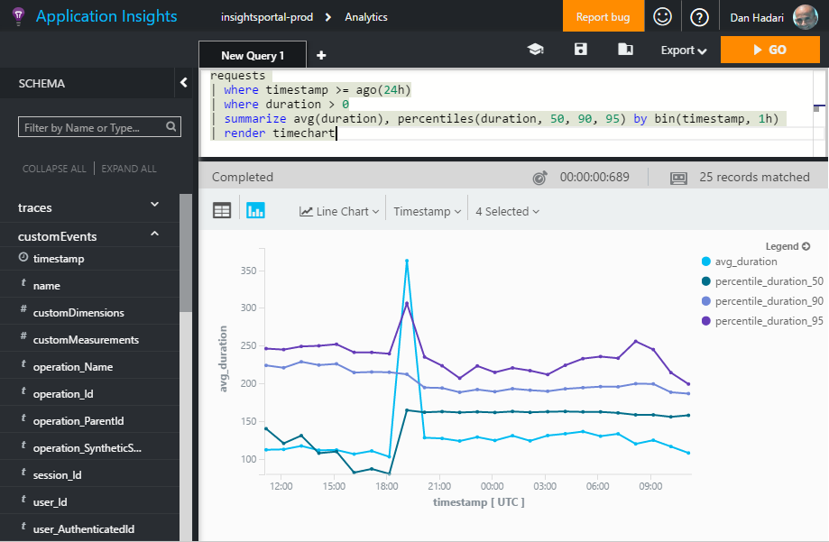
What is Application Insights?
3
Detect & Diagnose problems in Azure Portal; Ask ad-hoc queries in Analytics; Integrate, Extend & Customize
1
Telemetry is collected at each tier: server backend, middleware, web service & browser
2
Telemetry arrives in the cloud
where it is stored & processed with Machine Learning technology

Slide 14
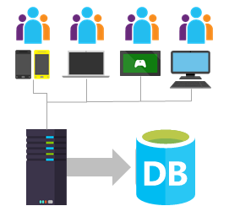

Sources of Telemetry
1
Outside-in monitoring
URL pings and web tests from 16 global points of presence
2
Observed user behavior
How is the application being used?
3
Developer traces and events
app
Whatever the developer would like to send to Application Insights
4
Observed application behavior
platform
No coding required – service dependencies, queries, response time, exceptions, logs, etc.
infrastructure
Infrastructure performance
5
System performance counters

Slide 15
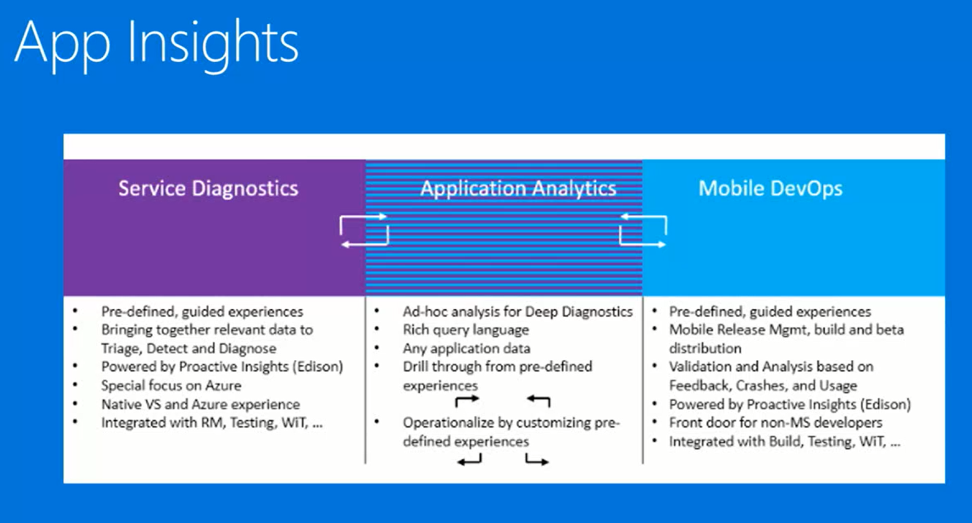

Slide 16
